Slide 1

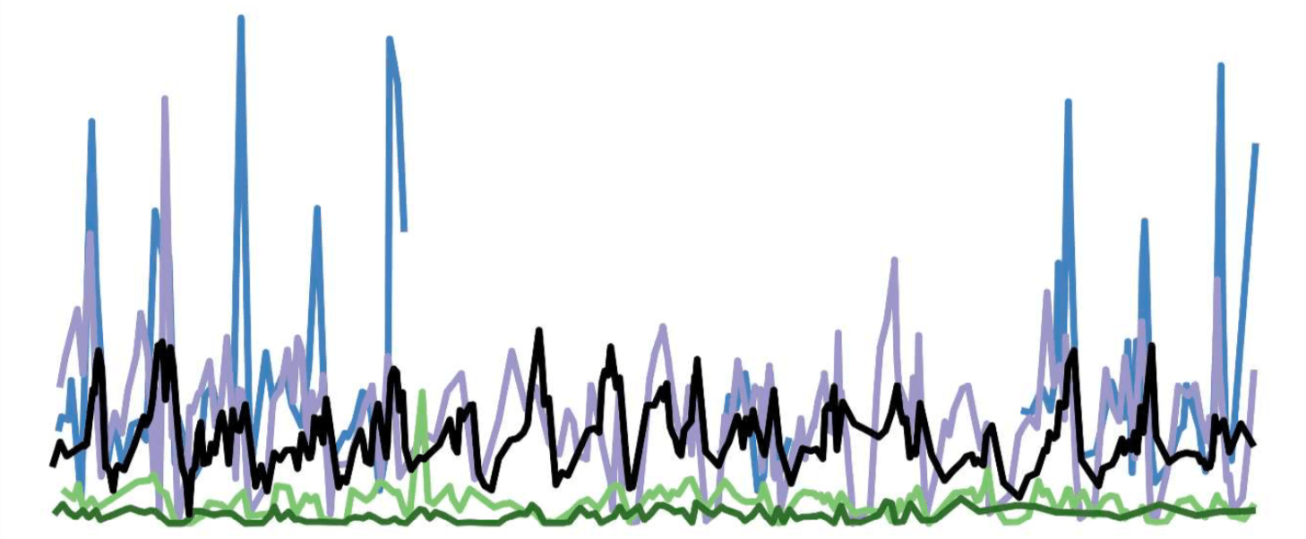
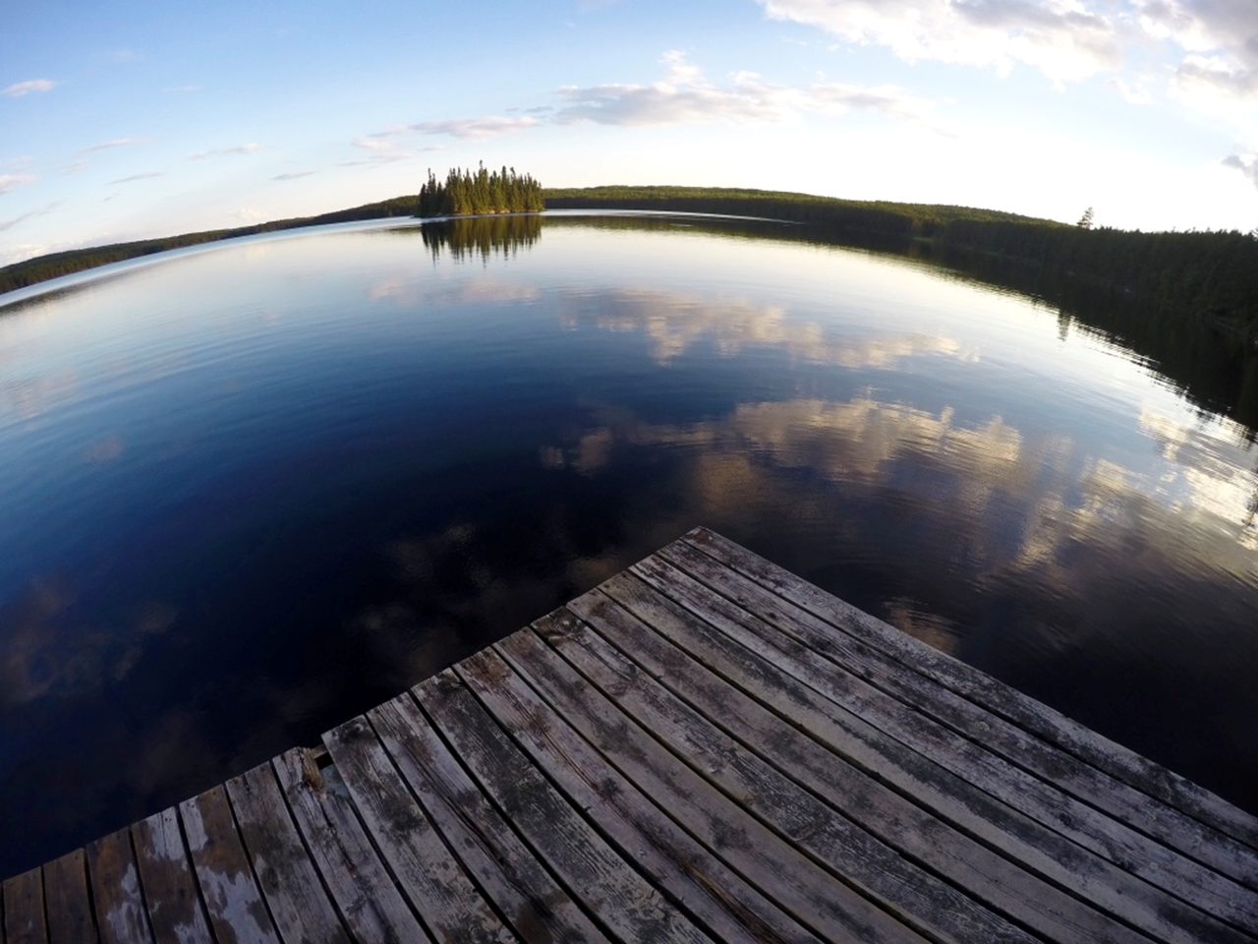
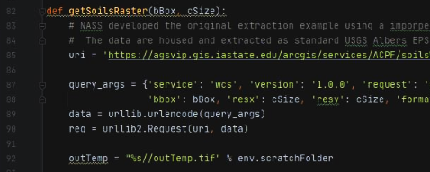
Python and geospatial science

Slide 2
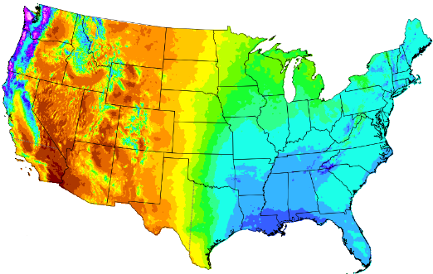
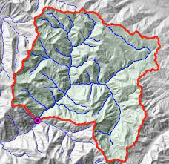
Goals for our interactive session:
1) Ingest spatial data from web sources
Example = PRISM climate data
2) Delineate and clip a watershed
Example = user defined lat/long and National Elevation Dataset
3) Aggregate spatial data to create summary statistics
Example = Summarize NLCD for watershed units (HUC12s)

Slide 3
Goals for our interactive session:
1) Ingest spatial data from web sources
Example = PRISM climate data
2) Delineate and clip a watershed
Example = user defined lat/long and National Elevation Dataset
3) Aggregate spatial data to create summary statistics
Example = Summarize NLCD for watershed units (HUC12s)

Slide 4
R Resources for rasters and statistics
Reading raster data in R
https://www.neonscience.org/resources/learning-hub/tutorials/raster-data-r
Rcran – Zonal package
https://search.r-project.org/CRAN/refmans/raster/html/zonal.html
Extractextractr – zonal stats developed by Dan Baston
https://github.com/isciences/exactextractr
Benchmarks show much faster than extract, not sure about zonal
Rcran – Extract package
https://www.rdocumentation.org/packages/raster/versions/3.4-13/topics/extract
Can handle vector summarizations on the fly
Likely the slowest package – can’t handle large geotiffs

Slide 5
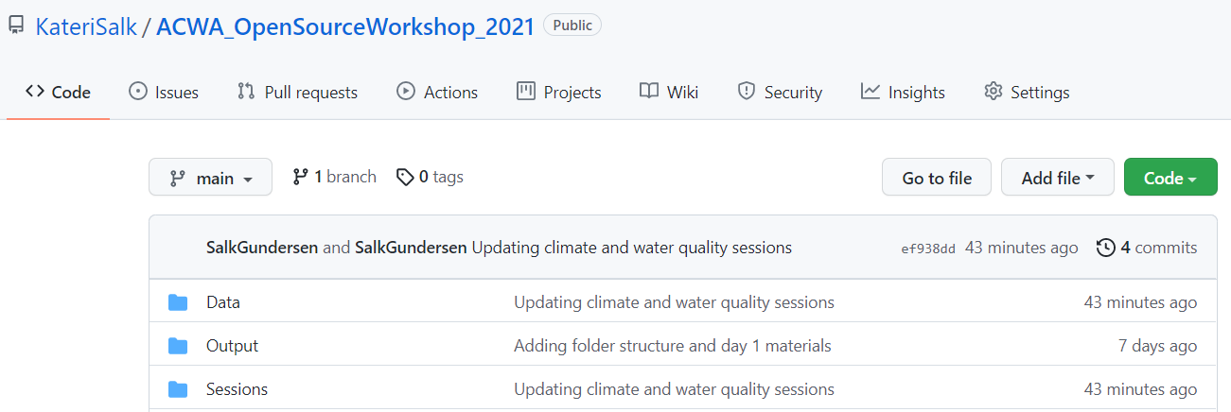
GitHub Example: Workshop Repository
https://github.com/KateriSalk/ACWA_OpenSourceWorkshop_2021

